Slide 1
How Colleges and Universities Can Improve Outcomes for Low-Income Students
Steven Brint

Slide 2
Why Post-Secondary Enrollments Grow
(in spite of legitimate cost and quality concerns)
Market/Institutional Reasons
Political Reasons
(1) Collapse of high school labor market
(2) Labor market benefits of college education
(3) Students’ sense that borrowing to pay for college is unavoidable and ultimately beneficial
(4) Colleges’ interest in growing enrollment as revenue source
(5) College marketing blitzes reinforce demand
(1)Bipartisan agreement on consequences for international competitiveness
(2) Public benefits (human capital development, opportunities for disadvantaged groups, and keeping college age students off the labor market)
(3) Federal and state subsidization, financial aid, and research support structures
(4) Very strong philanthropic support
(5) Interest groups advance access goals for under-represented students

Slide 3
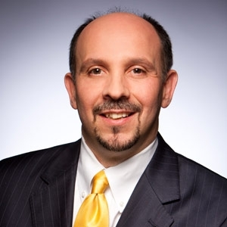
The College Completion Agenda
If this nation is to thrive in the global economy and continue to progress as a society, far more of our citizens need to be properly educated. This cannot be a surprise to anyone in this room today. All of you know very well that a proper education doesn’t end with a high school diploma. It just can’t. To attain and maintain a place in the middle class—and produce all of the economic and societal benefits such a position affords—Americans need the skills and knowledge that can only be gained in high-quality postsecondary programs. In a word, college is key …
Jamie Merisotis

Slide 4
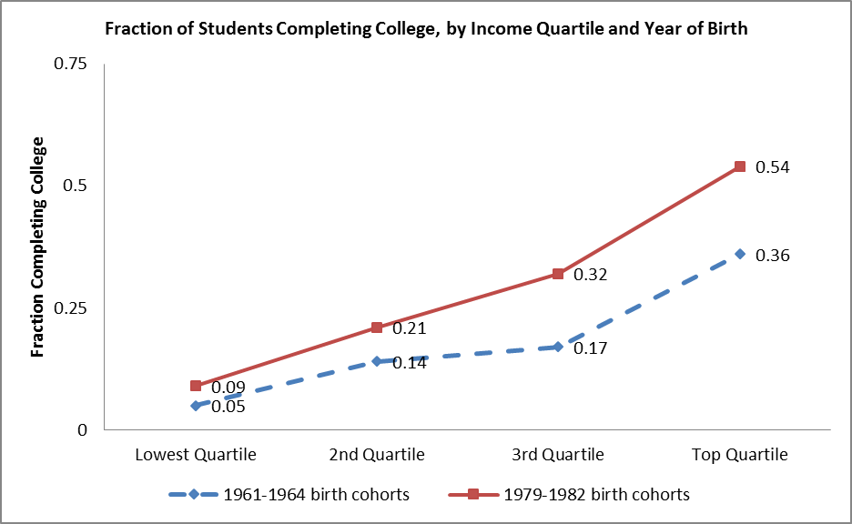
3.a. College Graduation by Income Quartiles
Source: Bailey & Dynarski (2011)

Slide 5
Differences in 6-Year Graduation Rates by Race-Ethnicity

Slide 6
Structural Factors at Play
* About two-thirds of the variance in six-year graduation rates in the United States can be explained by the average SAT/ACT score of entering freshmen.
* Declines in K-12 preparation are associated with non-completion at community colleges.
* At all institutions, high student-faculty ratios reflect inadequate resources and are associated with lower completion rates.
* As tuition increases, students shift to less expensive institutions. Graduation rates at less expensive institutions (e.g. state comprehensives and community colleges) are substantially lower than private colleges and public research universities.

Slide 7
Changes in Enrollment at U.S. Colleges & Universities, 1970-2010
Sources: Snyder (1993), NCES (2013)

Slide 8
Types of Interventions That Can Matter
1) Enrollment Management
2) Academic Support Services
3) Improved Teaching
4) Interventions related to Student Culture

Slide 9
1.Enrollment Management
1.a. Modeling the Number & Distribution of Seats
1.b. Balancing Impacted Majors
1.c. Automatic Re-optimization of Course Plans
1.d. Leveraging Summer

Slide 10
1.a. A Simple Course Demand Model
* Look at trends over 10 years for lower and upper division seats in each program.
* Based on these trends, choose one of three predictor choices: linear trend, last 3-years average, last year only.
*Determine proportions of needed seats in lower and upper division based on these predictor choices.
* Project out to anticipated next year’s enrollment, accounting for “summer melt”
* Build in expected loss between quarters or semesters
* Run on several scenario – 10%, -5%, expected, +5%, and +10% - to provide options.

Slide 11
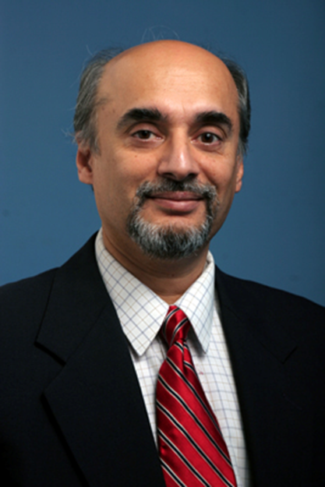
1.b. Automatic Re-optimization of Course Plans: A+
* 2 or 4- year course plans are a must.
* But they are not sufficient; students change their course plans.
* Too much advisor time is spent with students finding courses and setting schedules.
* System created by Chinya V. Ravishankar, a professor of computer science, allows for automatic re-optimization of course schedules to minimize time to degree.
* System saves advisor time and empowers students to engage in “what if?” planning.
Chinya V. Ravishankar

Slide 12
1.c. Balancing Impacted Majors through Resource Allocation Models
* A major problem is that students flock to business, social science, and health-related majors where inadequate resources are available to allow for reasonable student-faculty ratios.
* Incentive based budgeting can lead to rational allocation of resources across programs so that instructional resources reflect student demand. Provost retains % of funds for program-driven recruiting.
* Current model at several U.S. campuses bases proportion of instructional resources on three factors: 1) student credit hours, 2) number of majors, and 3) graduation rates in major. The latter is important so that programs do not invent programs to increase student credit hours and majors.

Slide 13

1.d. Leveraging Summer
* Students who take courses in summer are more likely to finish and more likely to finish on time than students who do not take courses in summer.
* Many summer programs are based on what professors want to teach rather than what students need to complete their programs in a timely way.
* The required shift in orientation is to provide high-demand courses regularly in summer at a reasonable price.
* Shift downward in number of units required to receive financial aid can be helpful to stimulate summer participation.

Slide 14
2. Academic Support
2.a. Advising
2.b. Learning Communities
2.c. Supplemental Instruction/Tutoring
2.d. Summer Bridge Programs

Slide 15
2.a. Frequent Visits to Advisors Matter, Especially for Less Prepared Students
Source: Klepfer & Hull (2012)

Slide 16
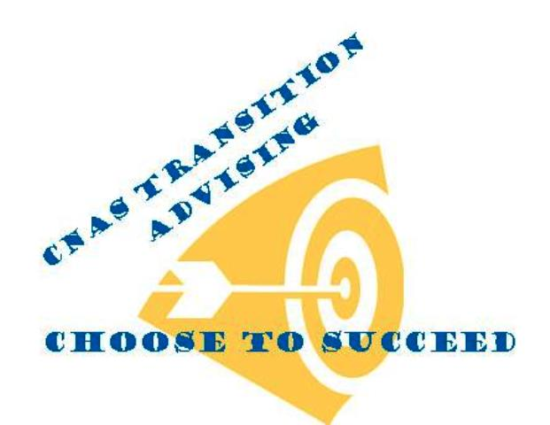
2.a. Early Transition Advising
2.a. Early Transition Advising
* Students who persist in programs in which they are very unlikely to succeed fail to make timely progress to degree and are less likely to graduate. The great majority of students who need transition advising are in STEM fields.
* The University of Texas starts transition advising after six weeks for science/engineering students, if their midterm grades in intro math and science are low.
* UC Riverside and many other campuses have moved from end-of-sophomore year transition advising to end-of-freshmen year transition advising.

Slide 17
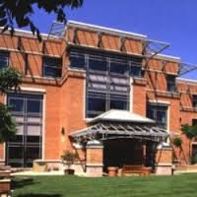

2.b. A Tale of Two Learning Communities
Science college
Hum/Social Science College
* Block scheduling
* Mandatory Supplemental Instruction
* Intensive advising
* Early research exposure
* Results: Sig. diff. between treatment and control groups in 5 of 7 years.
* Block scheduling
* Little or no communication/ planning among instructors
* Little focused attention to academic skills development
* Too many required workshops
* Results: No sig. diff. between treatment and control groups over 3 consecutive years.

Slide 18
2.b. Science Learning Communities:
Treatment vs. Control Groups, 2007-2013
Source: McKibben, Wallace & Silverstein 2013

Slide 19
2.c. Supplemental Instruction vs. Tutoring
* Fairly consistent national results for Supplemental Instruction: If students attend frequently, higher likelihood of A/B grades and lower likelihood of D/F/W grades.
* However, design matters here as well. Better results if strong communication with and acceptance by instructors, strong training for peer educators, and incentives for attendance.
* Tutoring has had much more mixed results. Less controlled environment, less consistent training of tutors, students who want answers rather than skill growth.

Slide 20
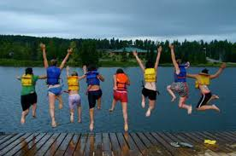
2.d. Problems with Summer Bridge
* Too few courses to replicate academic year terms
* Lack of financial resources make it difficult for students to attend
* Often no professional advising is offered
* Too few peer educators involved
* Students associate Bridge with negative high school summer make-up programs
* Summer camp atmosphere can develop

Slide 21
3. Improved Teaching
3.a. Teaching in Introductory Courses
3.b. Lessons from Cognitive Science
3.c. Adaptive Learning Technologies
3.d. Active Learning Practices

Slide 22
3.a. Placing the Best Teachers in Introductory Courses
Christopher Takacs & Dan Chambliss on why the best teachers should be teaching introductory courses:
"Faculty can positively or negatively influence student taste for a field -- some compelling teachers can get students engaged in fields that they previously disliked, while other, more uncharismatic faculty can alienate students from entire bodies of knowledge, sometimes permanently.
"It is important for department chairs and deans to recognize who their more skilled teachers are, and the teachers they can use to draw students into certain majors."
Source: Takacs & Chambliss (2013)

Slide 23
3.a. Alternative Pathways to Overcome the Introductory Math Problem?
* The biggest issues in student success relate to introductory mathematics.
*59% of community college students are placed into developmental math.
* Among community college students who are required to take 3 or more math classes in sequence, only 10% complete the gatekeeper math class.
* The Carnegie Foundation proposed alternative pathways to algebra and calculus for disciplines other than physics and engineering. These included a statistics pathway and a quantitative reasoning pathway.
* Carnegie’s first report showed that 51% of students in the statistics pathway completed a college-level math course in their first year compared to only 6% pursuing the standard pathway. (Source: Burdman 2013)

Slide 24
3.b. Using Lessons from Cognitive Science
* Before beginning instruction, teachers should determine what beliefs and misconceptions students currently have about a subject. Learners existing beliefs are often consistent with their everyday experiences.
* Meaningful learning (related to students’ experiences and interests) promotes better transfer than rote learning.
* Instruction is more effective when it encourages students to elaborate on what they are learning.
* Modes of instruction and activities in class should change every 15-20 minutes to facilitate focus and transfer.

Slide 25
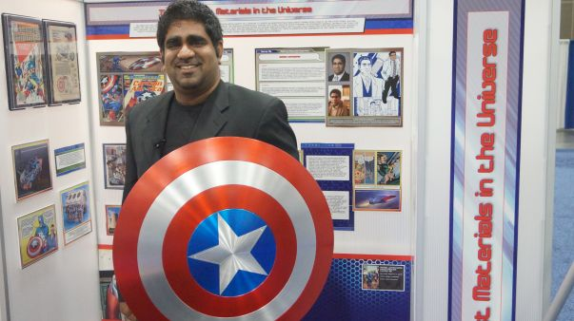
3.b. Using Superheroes to Teach Materials Science
Suveet Mathaudu, asst. prof. of materials science

Slide 26
3.c. Adaptive Learning Systems
ALEKS (Assessment and Learning in Knowledge Spaces) is an Internet based tutoring and assessment program that includes course material in mathematics, chemistry, introductory statistics, and business.
Rather than being based on numerical test scores, ALEKS uses the theory of knowledge spaces to develop a combinatorial understanding of the set of topics a student does or doesn't understand from the answers to its test questions. Based on this assessment, it determines the topics that the student is ready to learn and allows the student to choose from interactive learning modules for these topics.
ALEKS was initially developed at UC Irvine starting in 1994 with support from a large National Science Foundation grant.

Slide 27
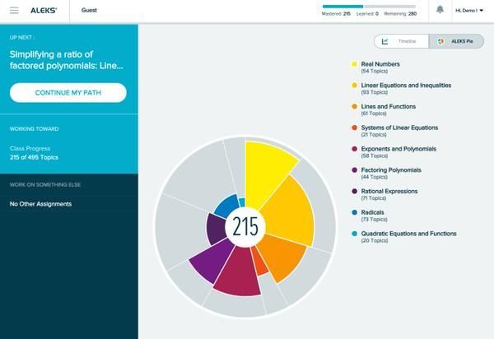
3.c. Example of a Student’s Algebra Knowledge Space in ALEKS

Slide 28
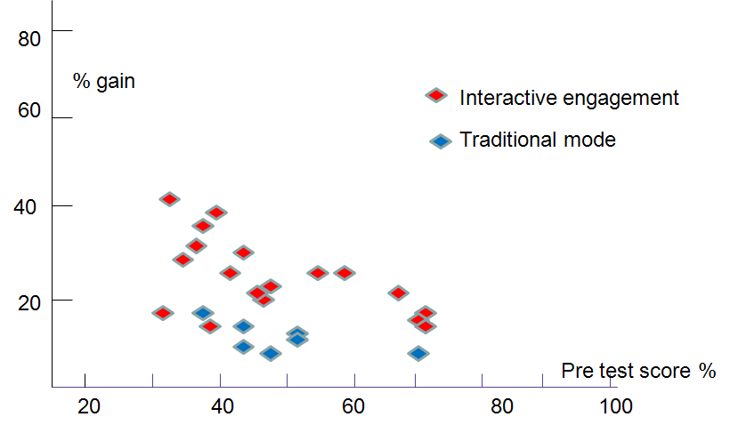
3.d. From Robert R. Hake (1998):
Lectures vs. Interactive Engagement

Slide 29
3.d. Active Learning Can Be Challenging for Less Prepared Students
* Shyness & insecurity are issues
* Clickers allow for anonymity while actively engaging
* Think-pair-share activities provide partnership opportunities
* Small groups of peers can be more conducive than asking for individual responses
* Nevertheless, the research evidence is strong that interactive engagement is important for students, and perhaps particularly for first-generation and low-income students

Slide 30
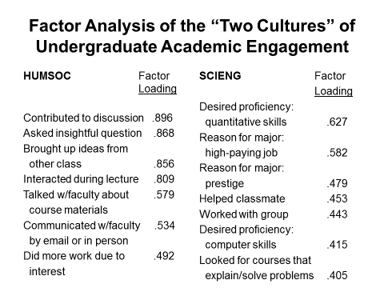
3.c. What Kinds of Active Learning?
Source: Brint, Cantwell & Hanneman (2008)

Slide 31
4. Student Culture
4.a. Fixed ability mindsets
4.b. GPA protectionism
4.c. Utilitarianism

Slide 32
4.a. Student Mindsets
Yeager & Dweck (2012) found that under-represented and first-generation freshmen exposed to messages about brain malleability and growth in abilities over time, followed by written reflections on these messages, were 4% more likely to complete 12 credits or more by the end of term compared to a control group of their peers who read informational messages about the culture of the campus community.

Slide 33



4.a. Mindset Theories
1) Duckworth “grit” theory: The decisive social psychological factor in students’ success is the belief and practice of sustained and focused application of talent and effort over time.
2) Dweck’s “growth mindset” theory: Students who believe that abilities are malleable and grow over time perform significantly better than otherwise similar students who believe that abilities are fixed.
3) Oettingen’s “positivist-realist” theory: Students who are optimistic about their capacity to succeed and are primed at the same time to be realistic about the risks and challenges they face better than students who are optimistic but fail to think through the challenges they face in realizing their goals.

Slide 34

4.b. Future Doctors of America
GPA Protection Society

Slide 35

4.b. Students Who Finish in 4 Save $$ and Have Higher GPAs
Many colleges have started “Finish-in-Four” campaigns, emphasizing:
1) The longer it takes, the less likely a student is to finish at all
2) The cost savings to families when students finish in four rather
than six years
3) The higher grades of students who finish in four

Slide 36
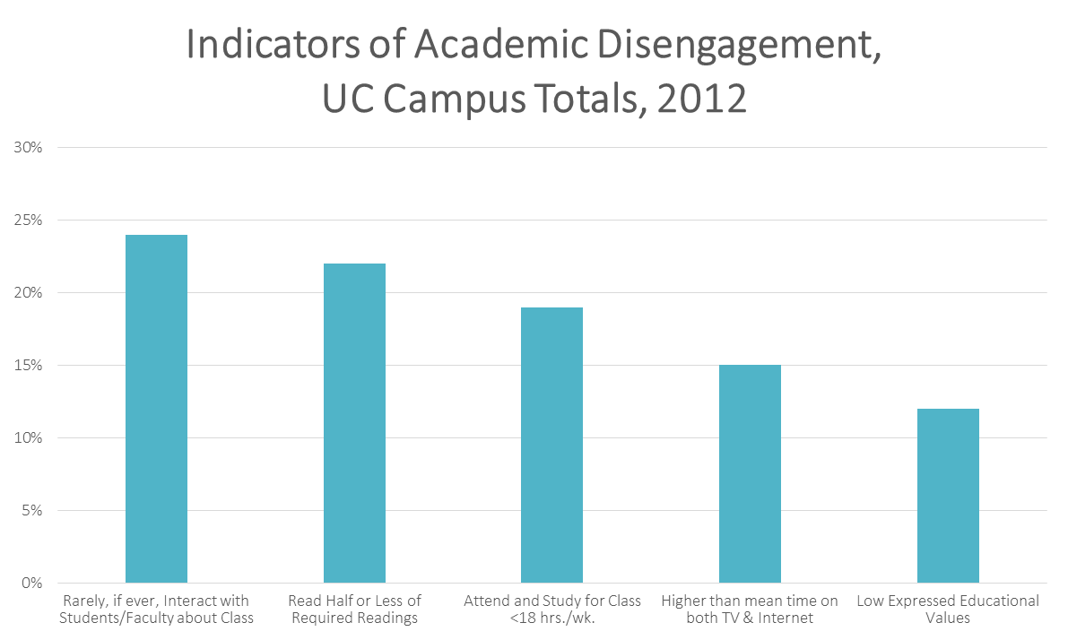
4.c. Student Utilitarianism?
Academic Disengagement at UC
Source: Brint & Cantwell (2014)

Slide 37
4.c. Reading Quizzes as an Antidote to
Student Utilitarianism
* Researchers have consistently found declines in completion of required reading among college students.
* To encourage student accountability, instructors are now making use of frequent sequential quizzing on required reading.
* A study by Pennebaker, Gosling & Ferrell (2013) found that exam performance improved by approx. one-half letter grade for treatment group as compared to control group experiencing no daily quizzes. The authors also found a 50% reduction in the achievement gap among students from different social classes.

Slide 38
Conclusions, I:
* The collapse of the high school labor market and other factors are encouraging a rapid increase in post-secondary enrollments.
* Changes in the costs of higher education and the resources available to higher education institutions are creating conditions for reduced completion rates.
* Even under these circumstances, colleges can raise the probabilities of student success for under-represented, first-generation, and low-income students.

Slide 39
Conclusions, II:
Among the programs that work, we find many that:
* Are mandatory
* Are intensive (including regular check-ins)
* Intervene early if performance problems arise
* Rely on technology to allocate resources, improve learning, and/or reduce advising labor
* Increase students’ active learning opportunities
* Encourage students’ expectations of cognitive growth
* Require accountability for students’ work effort
* Are regularly evaluated and redesigned when evaluations fail to show results

Slide 40
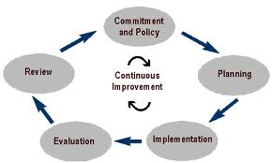
Continuous Improvement Cycle

Slide 41
Scaling Innovations
The UIA Goal
To improve outcomes for ALL students regardless of socioeconomic background.
To advance toward that goal, UIA member universities will act as an innovation cluster, developing and testing new initiatives, sharing data, and scaling best practices across the Alliance. Together, the Alliance institutions are going to share what is learned to help thousands more students each year achieve a college degree.
Notes:
Use this slide to:
- Set context 10,000 foot and “bringing it home” to the institutional contexts
- Discuss 10 year aim statement AND a shorter term (3 year) aim: What progress you want to make in the three years to get to this goal?
- Comment on the collaborative nature of the Alliance and the possibilities of learning faster by learning from each

